Slide 1


Department of BES-I
COURSE: Data Structures
COURSE CODE: 24SC1203
Topic:
Name of the topic:
Quick Sort

Slide 2



AIM OF THE SESSION
Quick sort Analysis Implementation
INSTRUCTIONAL OBJECTIVES
This Session is designed to:
Demonstrate The Divide and Conquer in Quick sort Function
Describe the Picking a pivot
List out the operations possible on the Partitioning.
Describe the Swapping Process
List out the advantages and applications of Quick sort
LEARNING OUTCOMES
At the end of this session, you should be able to:
Define Quick sort
Describe The Swapping process
Summarize definition, types and operations of quick sort and its applications

Slide 3
Quick Sort
INTRODUCTION
The quicksort algorithm starts by picking a pivot element and then subdivides the array. It then puts the smaller elements on the left side of the pivot and the larger ones on the right side. The partition of arrays continues until each array is left with a single element.
Divide: In Divide, first pick a pivot element. After that, partition or rearrange the array into two sub-arrays such that each element in the left sub-array is less than or equal to the pivot element and each element in the right sub-array is larger than the pivot element.
Conquer : Recursively, sort two subarrays with Quicksort.
Combine: Combine the already sorted array.

Slide 4
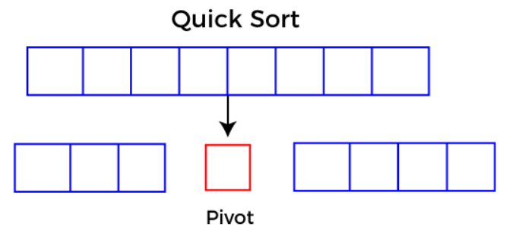
Quick Sort
INTRODUCTION CONT..
Quicksort picks an element as pivot, and then it partitions the given array around the picked pivot element. In quick sort, a large array is divided into two arrays in which one holds values that are smaller than the specified value (Pivot), and another array holds the values that are greater than the pivot.
After that, left and right sub-arrays are also partitioned using the same approach. It will continue until the single element remains in the sub-array.

Slide 5

Example of Quick sort
Working of Quick Sort Algorithm
Now, let's see the working of the Quicksort Algorithm.
To understand the working of quick sort, let's take an unsorted array. It will make the concept more clear and understandable.
Let the elements of array are -

Slide 6
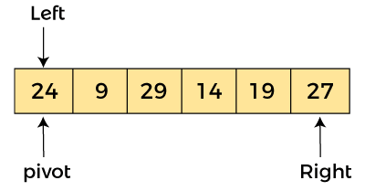
Quick sort Example Cont.…
In the given array, we consider the leftmost element as pivot. So, in this case, a[left] = 24, a[right] = 27
and a[pivot] = 24. Since, pivot is at left, so algorithm starts from right and move towards left.

Slide 7
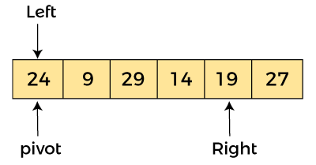
Quick sort Example (Cont..)
Now, a[pivot] < a[right], so algorithm moves forward one position towards left, i.e. -

Slide 8
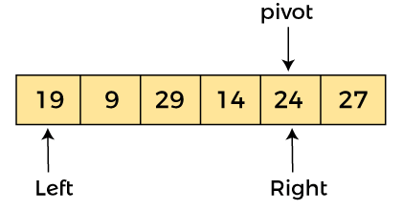
Quick sort Example (Cont..)
Now, a[left] = 24, a[right] = 19, and a[pivot] = 24.
Because, a[pivot] > a[right], so, algorithm will swap a[pivot] with a[right],
and pivot moves to right, as -

Slide 9
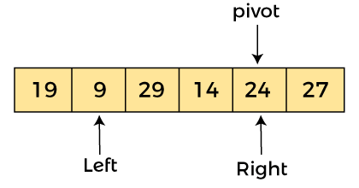
Now, a[left] = 19, a[right] = 24, and a[pivot] = 24. Since, pivot is at right, so algorithm starts from left and moves to right.
As a[pivot] > a[left], so algorithm moves one position to right as -

Slide 10
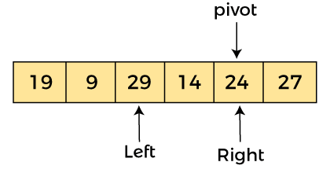
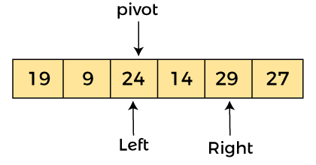
Now, a[left] = 9, a[right] = 24, and a[pivot] = 24. As a[pivot] > a[left], so algorithm moves one position to right as -
Now, a[left] = 29, a[right] = 24, and a[pivot] = 24. As a[pivot] < a[left], so, swap a[pivot] and a[left], now pivot is at left, i.e. -

Slide 11
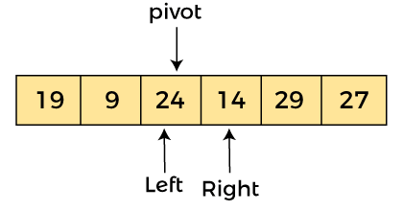
Since, pivot is at left, so algorithm starts from right, and move to left. Now, a[left] = 24, a[right] = 29, and a[pivot] = 24. As a[pivot] < a[right], so algorithm moves one position to left, as -

Slide 12
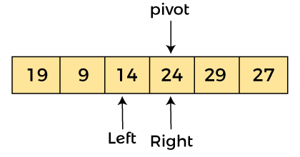
Now, a[pivot] = 24, a[left] = 24, and a[right] = 14. As a[pivot] > a[right], so, swap a[pivot] and a[right], now pivot is at right, i.e. -

Slide 13
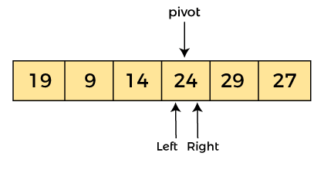
Now, a[pivot] = 24, a[left] = 14, and a[right] = 24. Pivot is at right, so the algorithm starts from left and move to right.

Slide 14
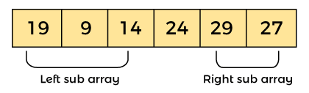
Now, a[pivot] = 24, a[left] = 24, and a[right] = 24. So, pivot, left and right are pointing the same element. It represents the termination of procedure.
Element 24, which is the pivot element is placed at its exact position.
Elements that are right side of element 24 are greater than it, and the elements that are left side of element 24 are smaller than it.

Slide 15

Now, in a similar manner, quick sort algorithm is separately applied to the left and right sub-arrays. After sorting gets done, the array will be -

Slide 16
Implementation of Quick sort
#include <stdio.h>
/* function that consider last element as pivot,
place the pivot at its exact position, and place
smaller elements to left of pivot and greater
elements to right of pivot. */
int partition (int a[], int start, int end)
{
int pivot = a[end]; // pivot element
int i = (start - 1);
for (int j = start; j <= end - 1; j++)
{
// If current element is smaller than the pivot
if (a[j] < pivot)
{
i++; // increment index of smaller element
int t = a[i];
a[i] = a[j];
a[j] = t;
}
}
int t = a[i+1];
a[i+1] = a[end];
a[end] = t;
return (i + 1);
}
/* function to implement quick sort */
void quick(int a[], int start, int end) /* a[] = array to be sorted, start = Starting index, end = Ending index */
{
if (start < end)
{
int p = partition(a, start, end); //p is the partitioning index
quick(a, start, p - 1);
quick(a, p + 1, end);
}
}

Slide 17
Implementation of Quick sort
/* function to print an array */
void printArr(int a[], int n)
{
int i;
for (i = 0; i < n; i++)
printf("%d ", a[i]);
}
int main()
{
int a[] = { 24, 9, 29, 14, 19, 27 };
int n = sizeof(a) / sizeof(a[0]);
printf("Before sorting array elements are - \n");
printArr(a, n);
quick(a, 0, n - 1);
printf("\nAfter sorting array elements are - \n");
printArr(a, n);
return 0;
}

Slide 18
IMPORTANT FACTS RELATED TO THE SESSION
Advantages of a Quick sort
Quick sort has a fast average-case time complexity of O(nlogn), making it efficient for large datasets.
It is a simple and easy-to-implement algorithm that can be implemented in a few lines of code.
Quick sort can be easily parallelized, making it suitable for use on multicore and distributed systems.
It is an in-place sorting algorithm, which means that it does not require additional memory to store temporary variables or data structures.
Disadvantages of a Quick sort
Quick sort has a worst-case time complexity of O(n^2) if the pivot element is chosen poorly or the data is already sorted.
It is not a stable sorting algorithm, which means that it does not guarantee the relative order of equal elements in the sorted array.
Quick sort is not suitable for sorting large datasets that do not fit in memory, as it requires multiple passes over the data.

Slide 19
IMPORTANT FACTS RELATED TO THE SESSION
Applications/Characteristics of quick sort
Quick sort divides an array into two sections according to a pivot element, usually the last element in the array.
All elements smaller than the pivot are put in one partition, and all elements larger than the pivot are placed in the other, dividing the array into two partitions.
The algorithm repeats this procedure for each division until the array as a whole is sorted.
If the data is already ordered or the pivot element is not carefully chosen, quick sort has a worst-case time complexity of O(n2).

Slide 20
Time Complexity of Quick sort
Let us consider the following terminologies:
T(K): Time complexity of quicksort of K elements
P(K): Time complexity for finding the position of pivot among K elements.
Best Case:
The best case occurs when we select the pivot as the mean. So here
T(N) = 2 * T(N / 2) + N * constant
Now T(N/2) is also 2*T(N / 4) + N / 2 * constant. So,
T(N) = 2*(2*T(N / 4) + N / 2 * constant) + N * constant
= 4 * T(N / 4) + 2 * constant * N.
So, we can say that
T(N) = 2k * T(N / 2k) + k * constant * N
then, 2k = N
k = log2N
So T(N) = N * T(1) + N * log2N. Therefore, the time complexity is O(N * logN).--→ eq1

Slide 21
SELF-ASSESSMENT QUESTIONS
Which of the following sorting algorithms is the fastest?
a) Merge sort
b) Quick sort
c) Insertion sort
d) Shell sort
2. Which of the following methods is the most effective for picking the pivot element?
a) First element
b) Last element
c) Median of three partitioning
d) Random element

Slide 22
TERMINAL QUESTIONS
1. Describe About Quick sort?
2. Implementation of Quick sort ?
3. Analyze the time complexity of Quick sort?
4. Summarize working principle of quick sort?

Slide 23
REFERENCES FOR FURTHER LEARNING OF THE SESSION
Reference Books:
  Mark Allen Weiss, Data Structures and Algorithm Analysis in C, 2010 , Second Edition, PearsonEducation.
  2. Ellis Horowitz, Fundamentals of Data Structures in C: Second Edition, 2015
  A.V.Aho, J. E. Hopcroft, and J. D. Ullman, “Data Structures And Algorithms”, Pearson Education, First Edition Reprint2003.
Sites and Web links:
1. https://nptel.ac.in/courses/106102064
2. https://in.udacity.com/course/intro-to-algorithms--cs215
3. https://www.coursera.org/learn/data-structures?action=enroll

Slide 24
THANK YOU
Team – Data Sructures

